Slide 1
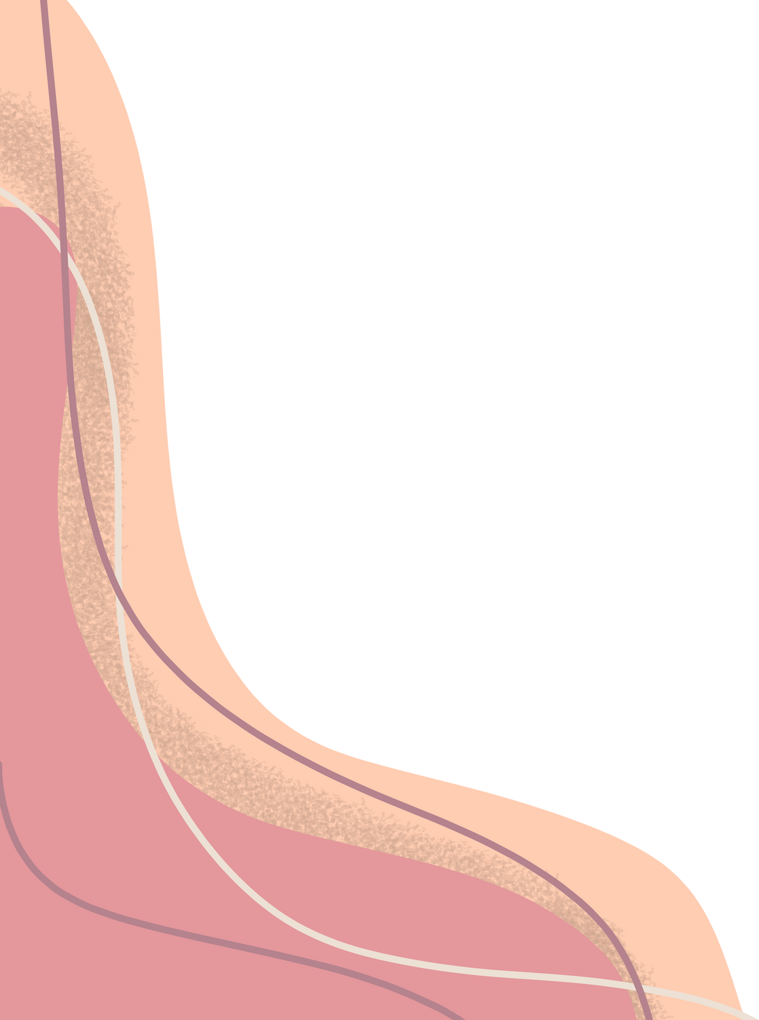


PREDICTING BIKE RENTALS
By Linda Lacsivy

Slide 2
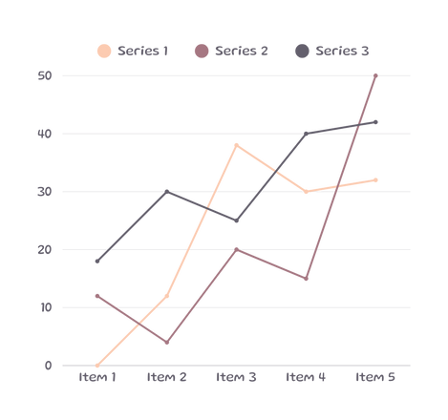
Agenda
data
identify ml problem
train models
evaluate models
optimize models
conclusion

Slide 3
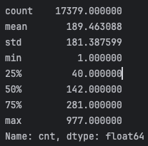
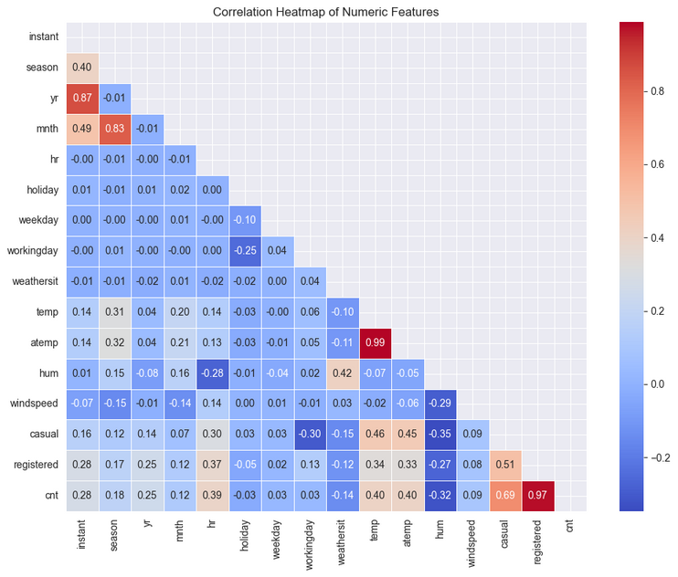
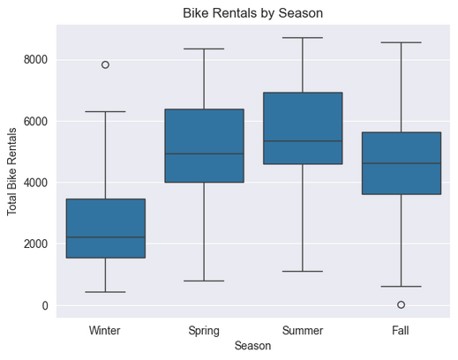
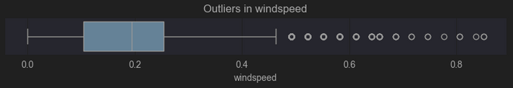
1. data
Features
Target: bike rentals ‘cnt’
Correlation map
explore, clean, adjust
Plots
Outliers

Slide 4
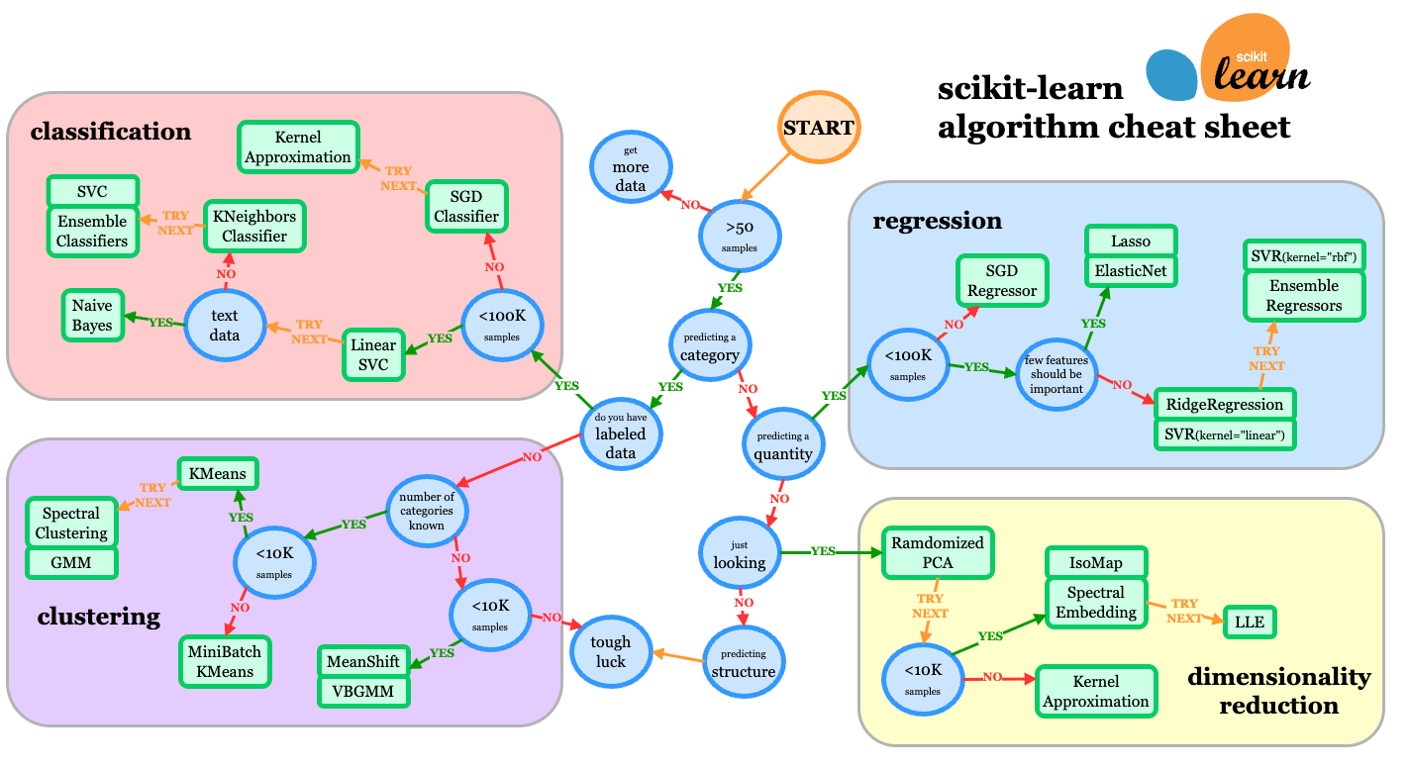
2. identify ml problem

Slide 5



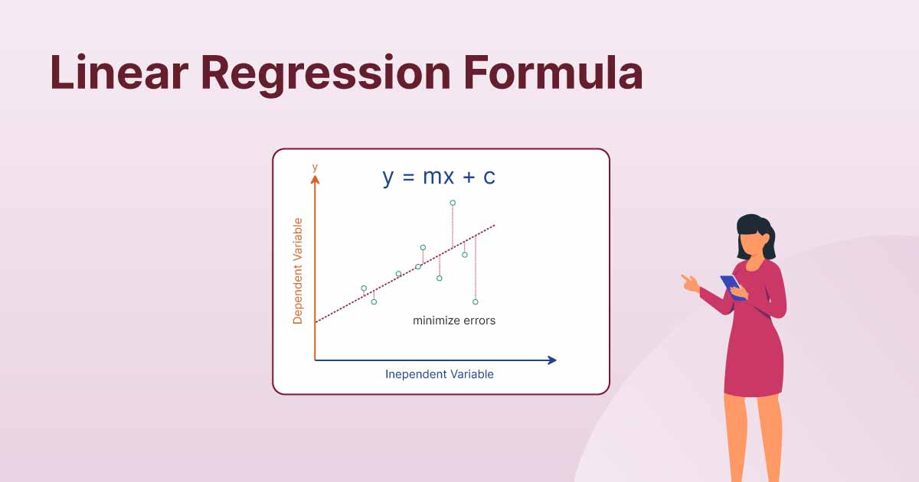
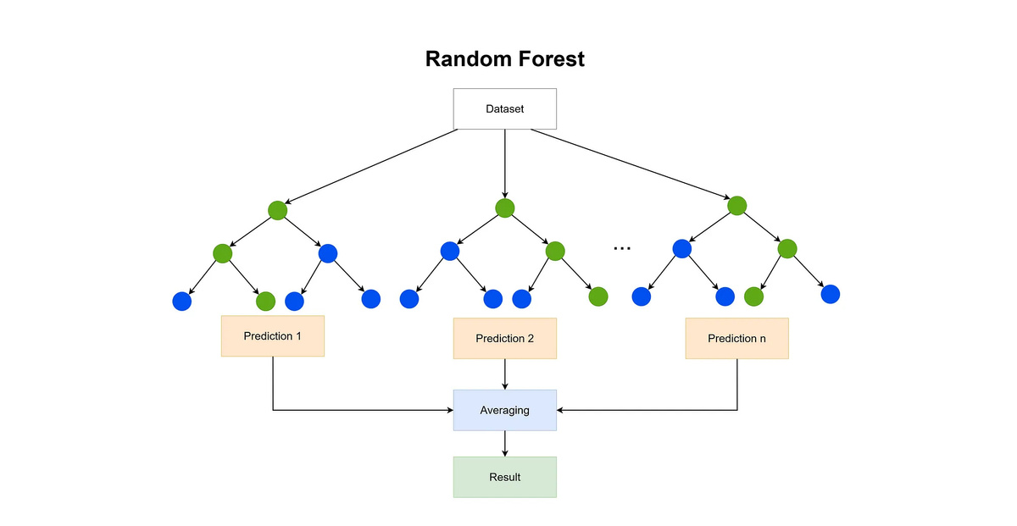
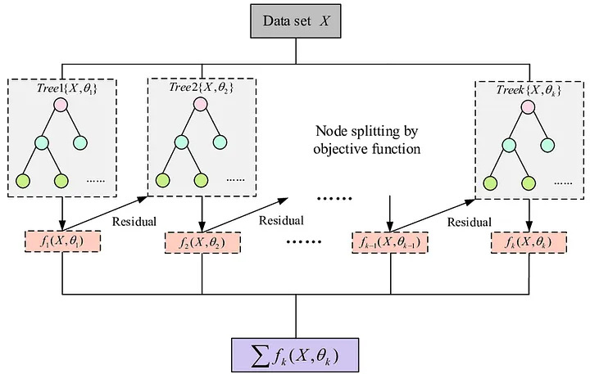
3. train models
Linear Model
Random Forest Model
eXtrem Gradient Boost Model

Slide 6
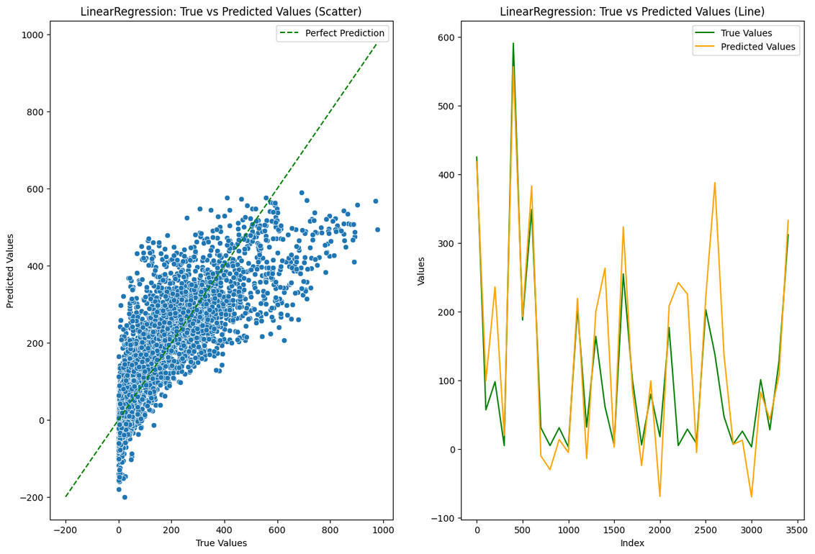
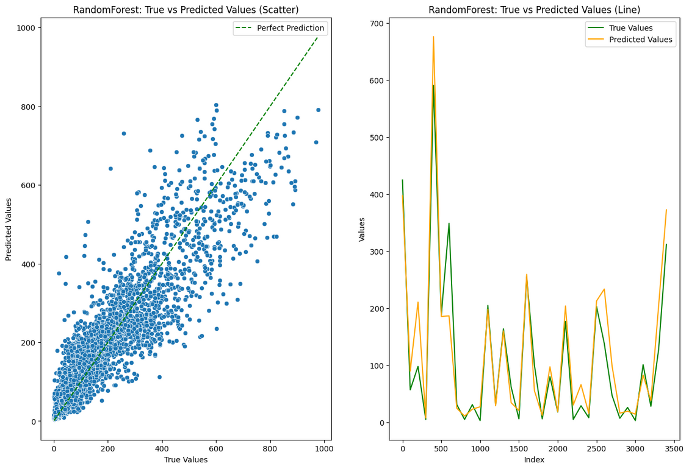
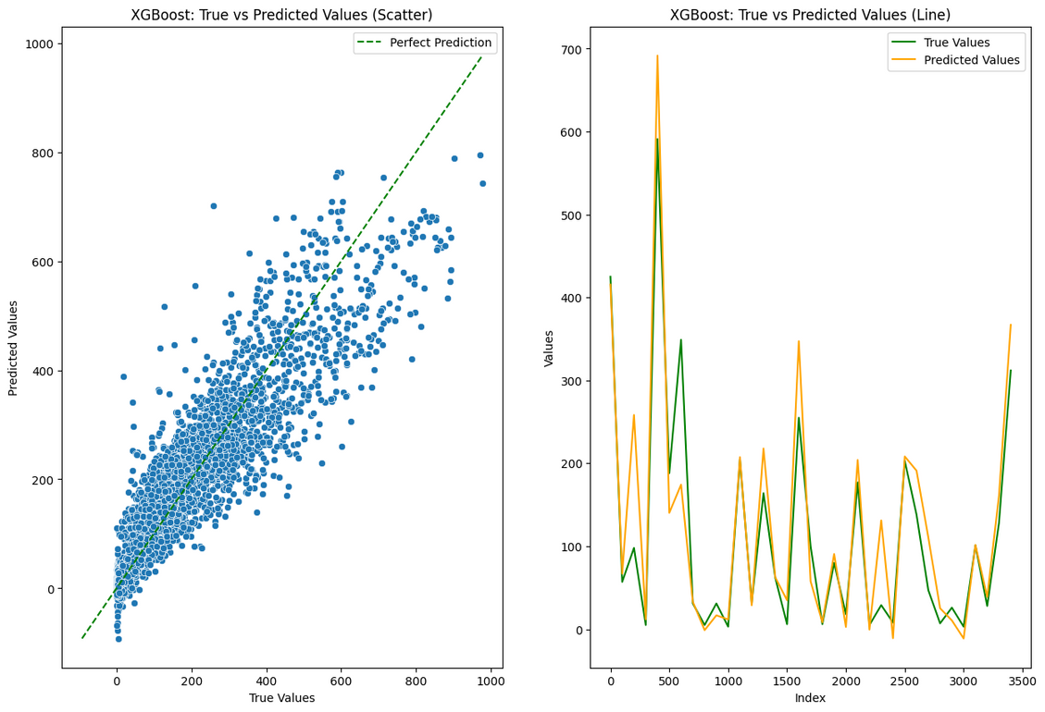
4. evaluate models
4.1. predicted vs true bike rentals
Linear Regression
Random Forest Regression
XGBoost Regression
predicted bike rentals
predicted bike rentals
predicted bike rentals
real bike rentals
real bike rentals
real bike rentals

Slide 7
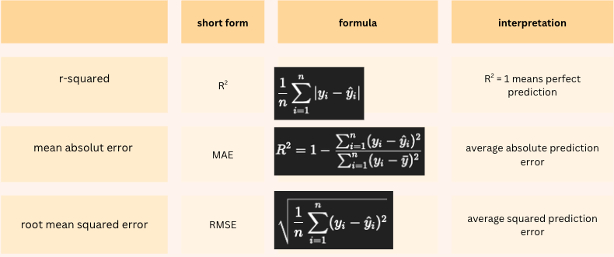
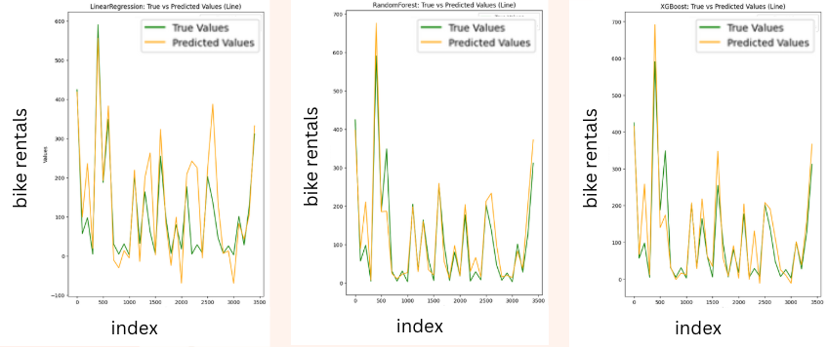
4. evaluate models
4.2. Metrics
Linear
Regression
Random Forest
Regression
XGBoost
Regression
METRICS | Linear Regression | Random Forest Regression | XGBoost Regression
R2 | 0.62 | 0.81 | 0.82
mae | 77 | 51 | 51
rmse | 108 | 76 | 74

Slide 8


5. optimize models
5.1. Ridge and Lasso Regression
OPTIMIZATION | Ridge Regression | Lasso Regression
penalty term added | sum of squared coefficients | sum of absolute coefficients
formula
METRICS | Linear Regression | Ridge Regression | Lasso Regression
R2 | 0.6266 | 0.6271 | 0.6276
mae | 77.8781 | 77.8275 | 77.7407
rmse | 108.7329 | 108.6538 | 108.590

Slide 9
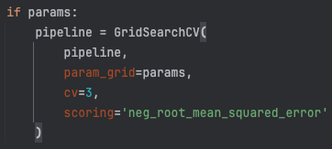
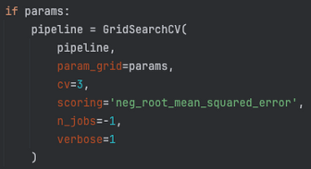

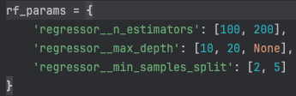
5.2. tuned Random forest Regression
OPTIMIZATION | Random Forest Regression | Tuned Random Forest Regression
extended GridSearch
tuned parameters
METRICS | Random Forest Regression | Tuned Random Forest Regression
R2 | 0.8133 | 0.8300
mae | 51.8918 | 47.7931
rmse | 76.8847 | 73.3524

Slide 10
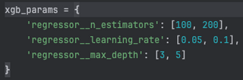
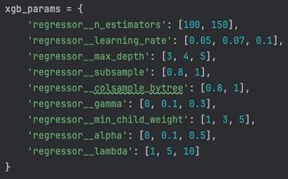
5.3. tuned XGBoost Regression
OPTIMIZATION | XGBoost Regression | Tuned XGBoost Regression
extended GridSearch
tuned parameters
METRICS | XGBoost Regression | Tuned XGBoost Regression
R2 | 0.8251 | 0.82427
mae | 51.0699 | 52.0300
rmse | 74.40827 | 74.5939

Slide 11











6. Conclusion
best result
Tuned Random Forest Regression
Great Machine Learning course
We learned a lot of new tools and got plenty of hands-on experience in only 1 week.
only little optimizations
my optimizations did hardly improve the results

Slide 12
Thank You

